Slide 1
Introduction to AWT and Swing

Slide 2
Java AWT
Java AWT (Abstract Window Toolkit) is an API to develop GUI or window-based applications in java.
Java AWT components are platform-dependent i.e. components are displayed according to the view of operating system. AWT is heavyweight i.e. its components are using the resources of OS.
The java.awt package provides classes for AWT api such as TextField, Label, TextArea, RadioButton, CheckBox, Choice, List etc.

Slide 3
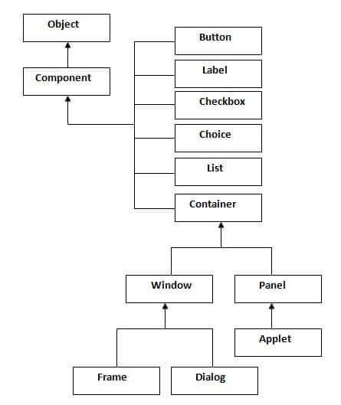
Java AWT Hierarchy

Slide 4
Swing

Slide 5
Introduction
Java Swing tutorial is a part of Java Foundation Classes (JFC) that is used to create window-based applications.
It is built on the top of AWT (Abstract Windowing Toolkit) API and entirely written in java.
Unlike AWT, Java Swing provides platform-independent and lightweight components.
The javax.swing package provides classes for java swing API such as JButton, JTextField, JTextArea, JRadioButton, JCheckbox, JMenu, JColorChooser etc.

Slide 6
Difference between AWT and Swing
No. | Java AWT | Java Swing
1) | AWT components are platform-dependent. | Java swing components are platform-independent.
2) | AWT components are heavyweight. | Swing components are lightweight.
3) | AWT doesn't support pluggable look and feel. | Swing supports pluggable look and feel.
4) | AWT provides less components than Swing. | Swing provides more powerful components such as tables, lists, scrollpanes, colorchooser, tabbedpane etc.
5) | AWT doesn't follows MVC(Model View Controller) where model represents data, view represents presentation and controller acts as an interface between model and view. | Swing follows MVC.

Slide 7
What is JFC
The Java Foundation Classes (JFC) are a set of GUI components which simplify the development of desktop applications.

Slide 8
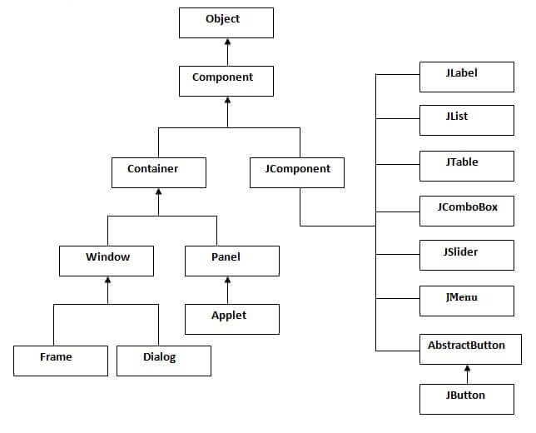
Hierarchy of Java Swing classes The hierarchy of java swing API is given below.

Slide 9
Commonly used Methods of Component class The methods of Component class are widely used in java swing that are given below.
Method | Description
public void add(Component c) | add a component on another component.
public void setSize(int width,int height) | sets size of the component.
public void setLayout(LayoutManager m) | sets the layout manager for the component.
public void setVisible(boolean b) | sets the visibility of the component. It is by default false.

Slide 10
Simple Java Swing Example
Let's see a simple swing example where we are creating one button and adding it on the JFrame object inside the main() method.
File: FirstSwingExample.java
import javax.swing.*;
public class FirstSwingExample {
public static void main(String[] args) {
JFrame f=new JFrame();//creating instance of JFrame
JButton b=new JButton("click");//creating instance of JButton
b.setBounds(130,100,100, 40);//x axis, y axis, width, height
f.add(b);//adding button in JFrame
f.setSize(400,500);//400 width and 500 height
f.setLayout(null);//using no layout managers
f.setVisible(true);//making the frame visible
}
}

Slide 11
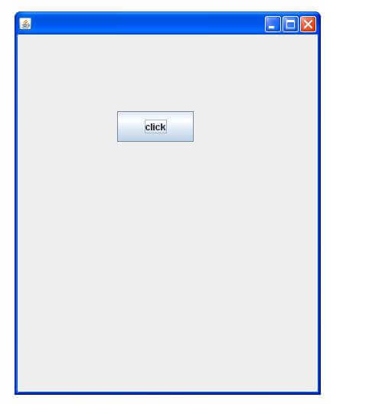
Output

Slide 12
Simple example of Swing by inheritance We can also inherit the JFrame class, so there is no need to create the instance of JFrame class explicitly.
File: Simple2.java
import javax.swing.*;
public class Simple2 extends JFrame{ //inheriting JFrame
//JFrame f;
Simple2(){
JButton b=new JButton("click");//create button
b.setBounds(130,100,100, 40);
add(b);//adding button on frame
setSize(400,500);
setLayout(null);
setVisible(true);
}
public static void main(String[] args) {
new Simple2();
}}

